Slide 1
ME469: Code Walk Through- CVFEM and EBVC
Stefan P. Domino^{1,2}
¹ Computational Thermal and Fluid Mechanics, Sandia National Laboratories
² Institute for Computational and Mathematical Engineering, Stanford
SAND2018-4536 PE

Slide 2
Edge-Based Vertex-Centered Leverages the Dual-Volume Element-based Description of a Control Volume Finite Element Method (CVFEM)
EBVC (A) and CVFEM (B) – As shown below, the dual-volume and integration point layout is very similar
(A)
(B)

Slide 3
Deep Dive on CVFEM
CVFEM is a discretization scheme that:
Iterates over locally-owned elements for Time/Source/etc. (volumetric-based terms)
Iterates over locally-owned elements for Advection/Diffusion/etc. (integrated by parts terms)
Below is the patch of elements connected to node 2 (a global matrix row number)
A dual-volume is defined within each element
Interpolation functions, or shape functions:
Volume and Surface examples:
8
5
6
1
2
3
7
4
Sample patch of elements

Slide 4
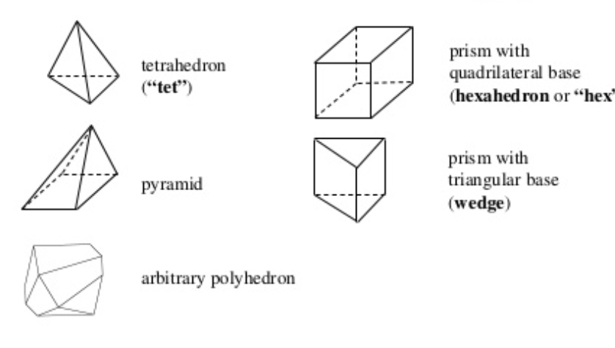
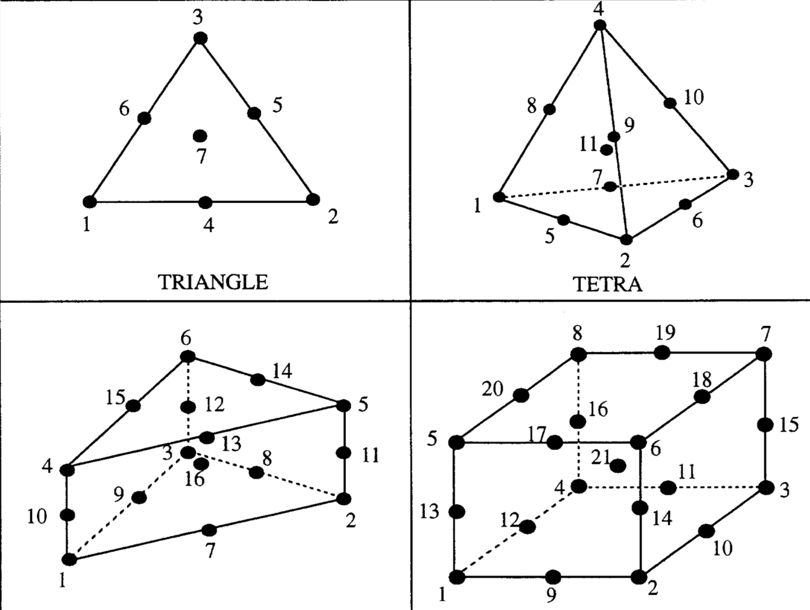
Examples of Various Topologies
Hex8
Tet4
Pyramid5
Wedge6
Arbitrary
Higher-order promoted elements (Hex27, Tet10, Wedge16, Hex64, etc.)

Slide 5
Code Design: Managing a Hybrid Mesh
Attributes:
Three unique topologies: quad_4, quad9, tri3
Iterate a set of “parts” that map to the homogeneous element blocks
Abstract out the integration rule, i.e., AlgTraits::nodesPerElement_, etc.
Create one algorithm per element topology type (avoids resizing)

Slide 6
Sample Nalu ElemKernel: Construction
Constructor defines the fields to gather and the element operations required,
e.g., dndx, area_vector, etc.

Slide 7
Sample Nalu ElemKernel: Execution
Design Point: Consolidated approach hides the element loop!
Thread-local scratch arrays using
A Kokkos SharedMemView
Templated
SIMD
MD-array rather than error-prone
pointer arithmetic

Slide 8
Implicit Solves - Refresher
We wish to solve in residual form (also known as delta-form)
Start with standard:
Transform to residual form:
Where M need not be equal to A:
do while (!converged) {
}
For a given
time step:

Slide 9
CVFEM Sample Code: Diffusion
// start the assembly
for ( int ip = 0; ip < AlgTraits::numScsIp_; ++ip ) {
// left and right nodes for this ip
const int il = lrscv_[2*ip];
const int ir = lrscv_[2*ip+1];
// compute ip property
DoubleType diffFluxCoeffIp = 0.0;
for ( int ic = 0; ic < AlgTraits::nodesPerElement_; ++ic ) {
const DoubleType r = v_shape_function_(ip,ic);
diffFluxCoeffIp += r*v_diffFluxCoeff(ic);
}
// assemble to rhs and lhs
DoubleType qDiff = 0.0;
for ( int ic = 0; ic < AlgTraits::nodesPerElement_; ++ic ) {
DoubleType lhsfacDiff = 0.0;
for ( int j = 0; j < AlgTraits::nDim_; ++j ) {
lhsfacDiff += -diffFluxCoeffIp*v_dndx(ip,ic,j)*v_scs_areav(ip,j);
}
qDiff += lhsfacDiff*v_scalarQ(ic);
// lhs; il then ir
lhs(il,ic) += lhsfacDiff;
lhs(ir,ic) -= lhsfacDiff;
}
// rhs; il then ir
rhs[il] -= qDiff;
rhs[ir] += qDiff;
}
}

Slide 10
CVFEM Sample Code: Time
for ( int ip = 0; ip < AlgTraits::numScvIp_; ++ip ) {
// nearest node to ip
const int nearestNode = ipNodeMap_[ip];
// zero out; scalar
DoubleType qNm1Scv = 0.0;
DoubleType qNScv = 0.0;
DoubleType qNp1Scv = 0.0;
DoubleType rhoNm1Scv = 0.0;
DoubleType rhoNScv = 0.0;
DoubleType rhoNp1Scv = 0.0;
for ( int ic = 0; ic < AlgTraits::nodesPerElement_; ++ic ) {
// save off shape function
const DoubleType r = v_shape_function_(ip,ic);
// scalar q
qNm1Scv += r*v_qNm1(ic);
qNScv += r*v_qN(ic);
qNp1Scv += r*v_qNp1(ic);
// density
rhoNm1Scv += r*v_rhoNm1(ic);
rhoNScv += r*v_rhoN(ic);
rhoNp1Scv += r*v_rhoNp1(ic);
}
// assemble rhs
const DoubleType scV = v_scv_volume(ip);
rhs(nearestNode) +=
-(gamma1_*rhoNp1Scv*qNp1Scv + gamma2_*rhoNScv*qNScv + gamma3_*rhoNm1Scv*qNm1Scv)*scV/dt_;
// manage LHS
for ( int ic = 0; ic < AlgTraits::nodesPerElement_; ++ic ) {
// save off shape function
const DoubleType r = v_shape_function_(ip,ic);
const DoubleType lhsfac = r*gamma1_*rhoNp1Scv*scV/dt_;
lhs(nearestNode,ic) += lhsfac;
}
}

Slide 11
The Control Volume for EBVC is Defined by the Dual-Volume
All primitives are collocated at the vertices of the elements with equal-order interpolation
A dual mesh is constructed to obtain flux and volume quadrature locations
Classic two-state, “L” and “R” approach provides spatially second-order accuracy
Iterate Nodes for volume-based contributions
Iterate Edges for surface-based contributions
Dual nodal volume
Area vector
T_{L}
n_{j}
T_{R}
Dual-volume definition
Edge-based stencil

Slide 12
An EBVC Algorithm
Regardless of topology (restricted to low-order), edges are unique
Therefore, the topology over which we loop is the edge2 with “L” and “R” nodes, respectively, and the single nodal

Slide 13
EBVC Sample Code: Diffusion
for ( stk::mesh::Bucket::size_type k = 0 ; k < length ; ++k ) {
// get edge
stk::mesh::Entity edge = b[k];
// left and right nodes
stk::mesh::Entity nodeL = edge.edge_node_rels[0];
stk::mesh::Entity nodeR = edge.edge_node_rels[1];
const double viscIp = 0.5*(diffFluxCoeffL + diffFluxCoeffR);
const double qNp1L = *stk::mesh::field_data( scalarQNp1, nodeL );
const double qNp1R = *stk::mesh::field_data( scalarQNp1, nodeR );
double lhsfac = -viscIp*asq*inv_axdx;
double diffFlux = lhsfac*(qNp1R - qNp1L) + nonOrth;
// first left
p_lhs[0] = -lhsfac;
p_lhs[1] = +lhsfac;
p_rhs[0] = -diffFlux;
// now right
p_lhs[2] = +lhsfac;
p_lhs[3] = -lhsfac;
p_rhs[1] = diffFlux;
}
L
R
x

Slide 14
EBVC Sample Code: Time
void
ScalarMassBDF2NodeSuppAlg::node_execute(
double *lhs,
double *rhs,
stk::mesh::Entity node)
{
// deal with lumped mass matrix
const double qNm1 = *stk::mesh::field_data(*scalarQNm1_, node);
const double qN = *stk::mesh::field_data(*scalarQN_, node);
const double qNp1 = *stk::mesh::field_data(*scalarQNp1_, node);
const double rhoNm1 = *stk::mesh::field_data(*densityNm1_, node);
const double rhoN = *stk::mesh::field_data(*densityN_, node);
const double rhoNp1 = *stk::mesh::field_data(*densityNp1_, node);
const double dualVolume = *stk::mesh::field_data(*dualNodalVolume_, node);
const double lhsTime = gamma1_*rhoNp1*dualVolume/dt_;
rhs[0] -= (gamma1_*rhoNp1*qNp1 + gamma2_*qN*rhoN + gamma3_*qNm1*rhoNm1)*dualVolume/dt_;
lhs[0] += lhsTime;
}

Slide 15
EBVC Sample Code: Complex LES-based Example
void
TurbKineticEnergyKsgsNodeSourceSuppAlg::node_execute(
double *lhs,
double *rhs,
stk::mesh::Entity node)
{
// filter
double filter = std::pow(dualVolume, 1.0/nDim_);
int nDim = nDim_;
double Pk = 0.0;
for ( int i = 0; i < nDim; ++i ) {
const int offSet = nDim*i;
for ( int j = 0; j < nDim; ++j ) {
Pk += dudx[offSet+j]*(dudx[offSet+j] + dudx[nDim*j+i]);
}
}
Pk *= tvisc;
double Dk = cEps*rho*std::pow(tke, 1.5)/filter + lrksgsfac_*2.0*visc*dsqrtkSq;
if ( Pk > tkeProdLimitRatio_*Dk )
Pk = tkeProdLimitRatio_*Dk;
rhs[0] += (Pk - Dk)*dualVolume;
lhs[0] += 1.5*cEps*rho*std::sqrt(tke)/filter*dualVolume;
}

Slide 16
CVFEM Sample Code: Complex LES-based Example (snippet)
for (int ic = 0; ic < AlgTraits::nodesPerElement_; ++ic) {
for (int ip=0; ip < AlgTraits::numScvIp_; ++ip) {
const DoubleType r = v_shape_function_(ip, ic);
tkeIp += r*v_tkeNp1(ic);
rhoIp += r*v_densityNp1(ic);
tviscIp += r*v_tvisc(ic);
dualNodalVolIp += r*v_dualNodalVolume(ic);
cEpsIp += r*v_cEps(ic);
viscIp += r*v_visc(ic);
for ( int i = 0; i < AlgTraits::nDim_; ++i ) {
const DoubleType sqrtk = stk::math::sqrt(v_tkeNp1(ic));
w_dsqrtkdx[i] += v_dndx(ip,ic,i)*sqrtk;
const DoubleType ui = v_velocityNp1(ic,i);
for ( int j = 0; j < AlgTraits::nDim_; ++j ) {
w_dudx[i][j] += v_dndx(ip,ic,j)*ui;
}
}
}
}

